Slide 1

DSC 2020 DONORS SELECTION CAMPAIGN
DESCRIPTIVE AND PREDICTIVE ANALYTICS
NOVEMBER 8TH 2021

Slide 2

Our goal
Create a predictive model that improves the performance of the 2020 donation campaign.
DESCRIPTIVE AND PREDICTIVE ANALYTICS

Slide 3

TEAM 5
Harikrishnan Gopalakrishnan
Mario
Serrano
Fernando
Delgado

Slide 4
AGENDA
Data Preparation
Model Building and Validation
Ideal Donor Profiling
Business Case

Slide 5
DATA PREPARATION

Slide 6

DATA PREPARATION
TIMELINE
04/08/2018
18/05/2019
01/01/2020
Train Set
Test Set
15 years
Scoring

Slide 7
DATA PREPARATION
Province/Region
Age/Age Group
RFM
Additional Dummies
Donations (€)
Donors
Gifts
Campaigns

Slide 8
MODEL BUILDING & VALIDATION

Slide 9



MODEL BUILDING & VALIDATION
Ran a Univariate Feature Selection with a p-value of 0.1 to avoid overfitting
Created a base-table with 38 features from the dataset.
Selected 17 features to run our predictive model

Slide 10

MODEL BUILDING & VALIDATION
Gender
Preferred Language
Lives in Flanders
Lives in Wallonia
Lives in Brussels
Lives in Hainaut
Lives in Walloon Brabant
Donated more than once
Donated more than five times
Donated more than €30.0
Donated more than 95% of donors
Daily recency
Monthly Recency
RFM Score
RFM Level
Age
Age Group
Selected features
Validate model

Slide 11
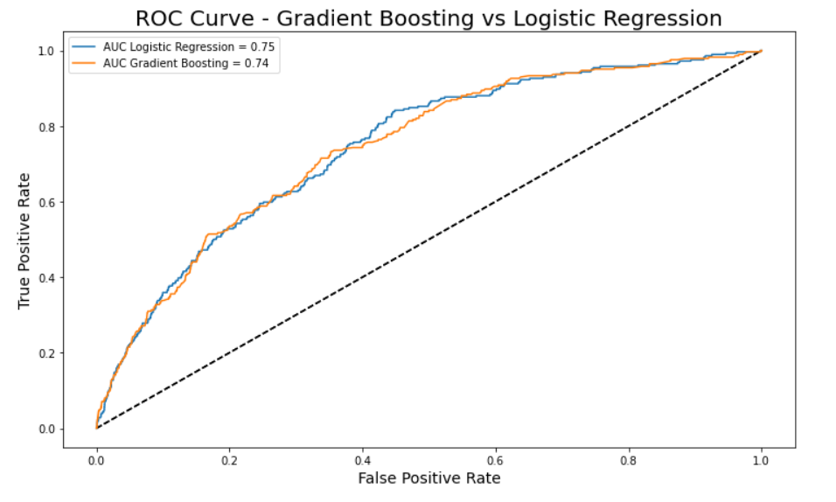
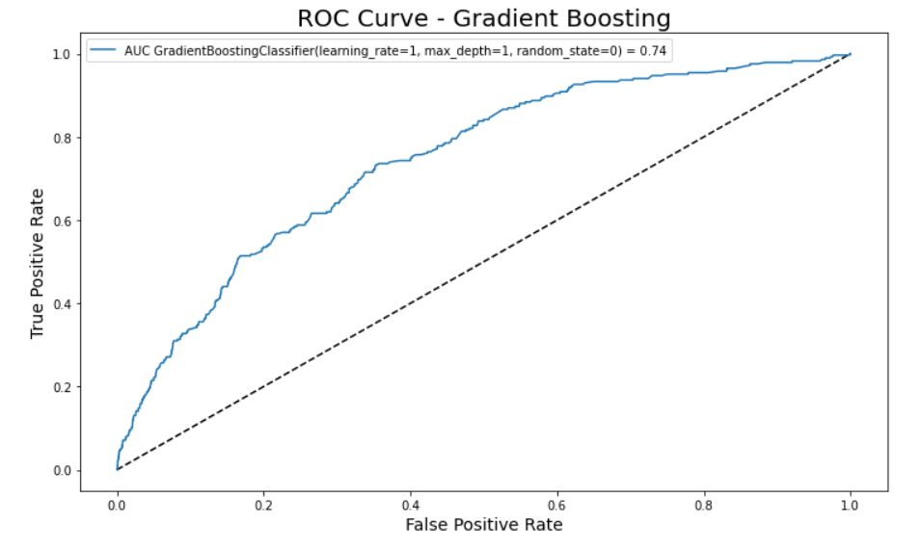
MODEL BUILDING & VALIDATION
Model | Decision Tree | Logistic Regression | Random Forest | Gradient Boosting | Support Vector Machines | Neural networks | K-Nearest Neighbours
Accuracy | 0.9467 | 0.9727 | 0.9701 | 0.9727 | 0.9727 | 0.9727 | 0.9727
AUC | 0.5222 | 0.7459 | 0.6482 | 0.7445 | 0.5725 | 0.6509 | 0.5186
AUC TRAIN: 0.7481
AUC TEST: 0.7459
AUC TRAIN: 0.7829
AUC TEST: 0.7445

Slide 12
IDEAL DONOR PROFILING

Slide 13
PARETO PRINCIPLE
SORT DATA
EFFORT
RESULTS
+
Top 20%
Ideal
Donors
20%
80%
-
Worst 20%
Non-Ideal
Donors

Slide 14
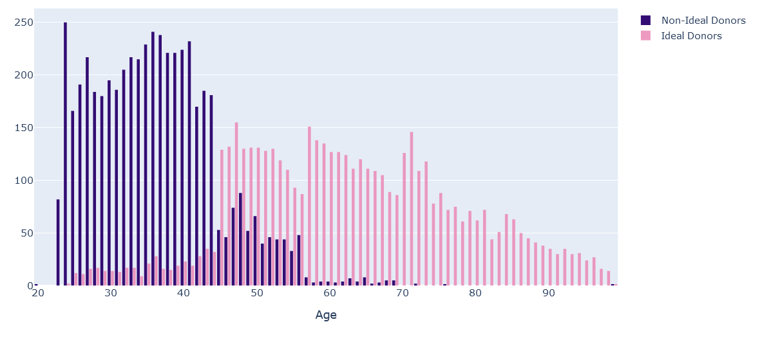
DONORS BY AGE
Ideal Donor Mean Age: 62
Non-Ideal Donor Mean Age: 36

Slide 15
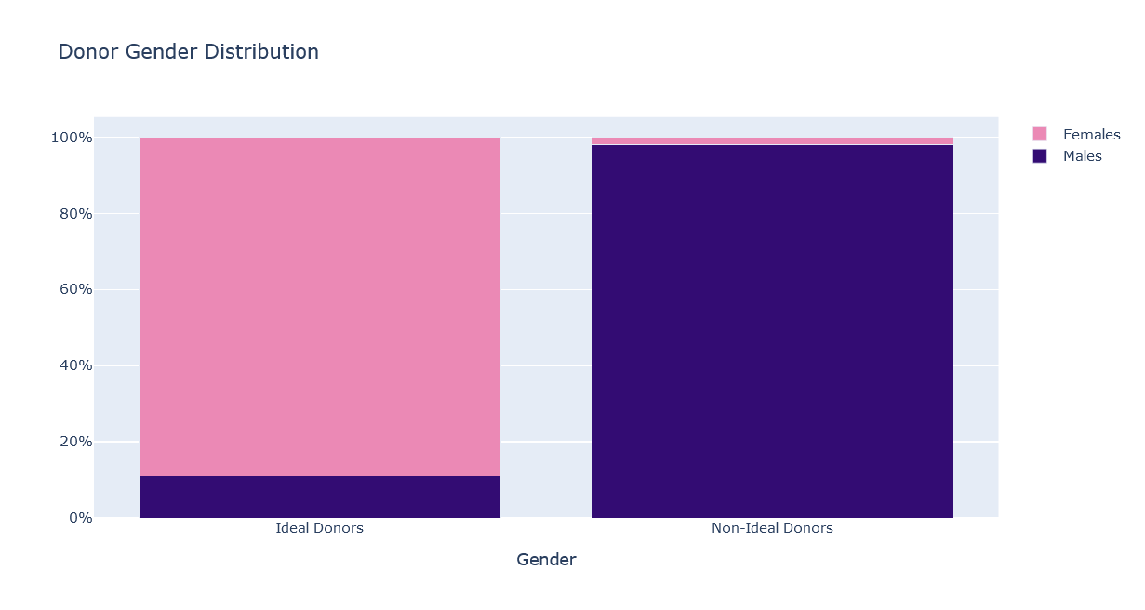
DONORS BY GENDER
2%
89%
98%
11%

Slide 16
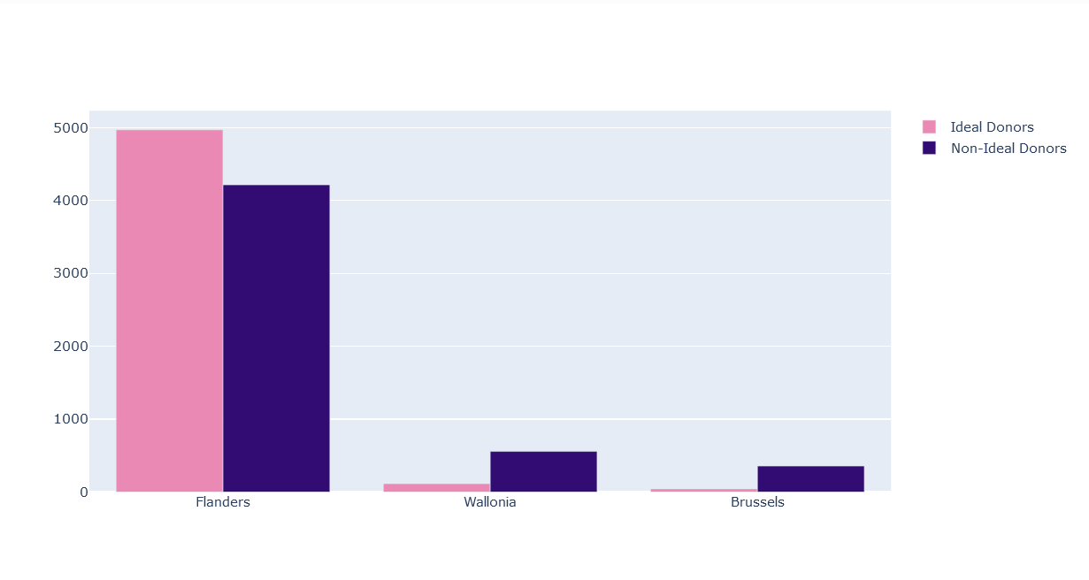
DONORS BY REGION

Slide 17
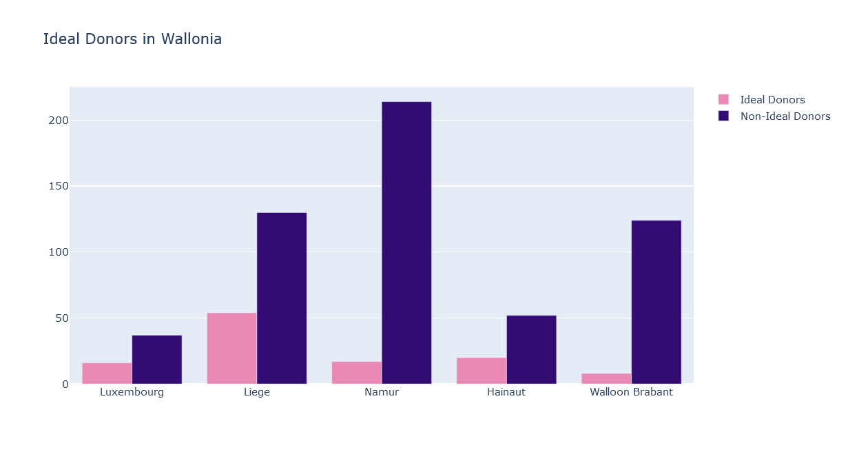
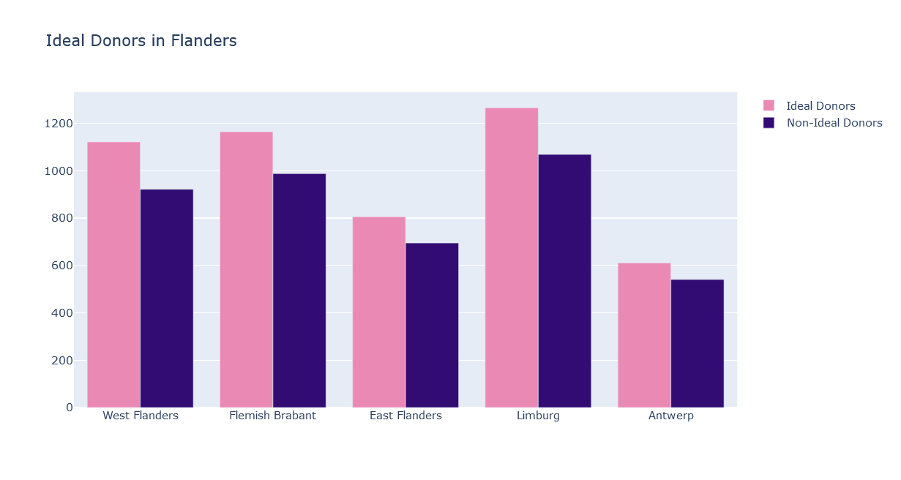
DONORS BY PROVINCE

Slide 18
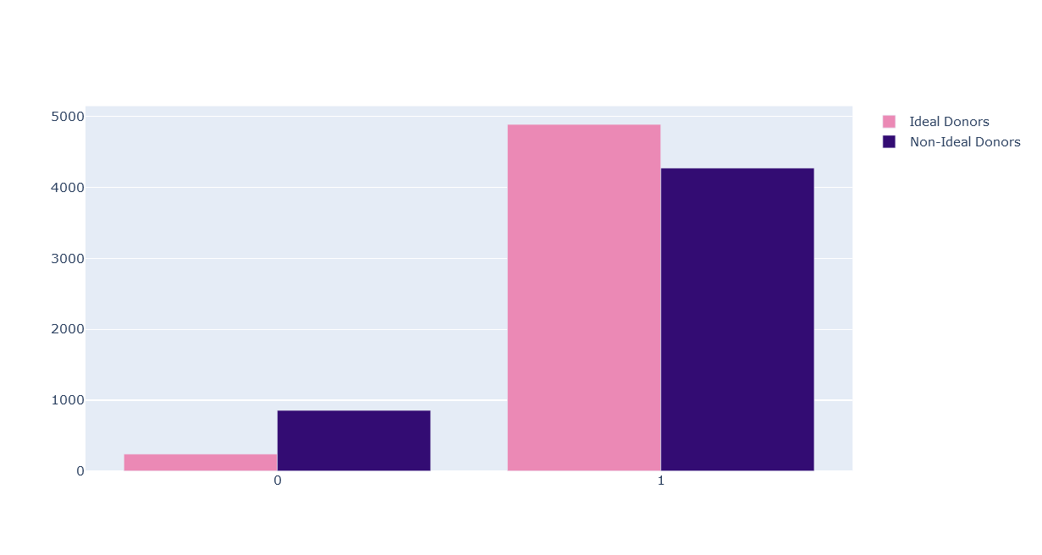
DONORS BY GENDER
French
Dutch

Slide 19
BUSINESS CASE

Slide 20
CUMULATIVE RESPONSE & LIFT
Response
Cumulative Response
20%
1.58%
40%
1.39%
60%
1.12%
80%
0.98%
100%
0.85%

Slide 21
CUMULATIVE RESPONSE & LIFT
Lift
Cumulative Response

Slide 22
CUMULATIVE GAINS & PROFIT
Cumulative Gain
Gains
20%
37%
40%
65%
60%
79%
80%
93%
100%
100%

Slide 23
CUMULATIVE GAINS & PROFIT
Mail Cost € 0.80
Average Donation € 76.88
Total People 25,642
Random Response Rate 0.85%
Cumulative Gain
Cumulative Profit

Slide 24
Thank You!
¡Gracias!
நன்றி

